Slide 1
Year 6: Light
For parents
Thank you for supporting your child’s learning in science.
Before the session:
Please read slide 2 so you know what your child is learning and what you need to get ready.
As an alternative to squared paper, slide 5 may be printed for your child to record on.
During the session:
Share the learning intentions on slide 2.
Support your child with the main activities on slides 3, 4 & 5, as needed.
Slide 6 has some further, optional activities.
Slide 7 has a glossary of key terms.
Reviewing with your child:
Slide 8 gives an idea of what your child may produce.
What time is the Sun highest in the sky?
Year 6 Age 10-11

Slide 2
Light
What time is the Sun highest in the sky?
Key Learning
The size of the Sun’s shadow changes throughout the day.
The Sun rises in the East and sets in the West.
The Sun is highest in the sky in the middle of the day.
Activities (pages 3-5): 70-80 mins across the day
What would help to support learning:
a sunny day and morning start (before 10am)
Note: Example results are given on page 5 if it’s not sunny.
paved/concrete area away from buildings
plastic bottle/something pointy ~20cm tall
chalk or a pencil
ruler/tape measure
Use squared paper, a ruler and a pencil for recording. Alternatively you may wish to print page 5 as a worksheet.
Find out more… (page 6)
You may like to explore sundials and make one.
I can…
observe and record the size of shadows through the day.
plot a line graph of results taken to one decimal place.
draw a conclusion from my data.

Slide 3
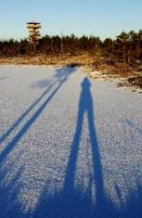
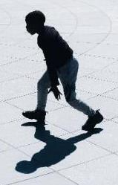
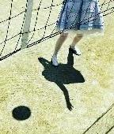
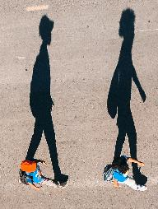
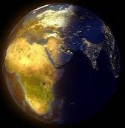
Explore, review, think, talk…
What do you already know about shadows outside on a sunny day?
(10-15 minutes)
Think or talk about…
What causes shadows on a sunny day? Use 4 scientific words or phrases to explain them.
What time of day do you think each of these photographs was taken?
Why do the size and direction of outdoor shadows change over time on a sunny day and what has this got to do with our planet Earth rotating on its axis?
Shadows are seen when light rays travelling in straight lines from the Sun (a light source) are blocked from reaching a surface or screen by an opaque object.
Long shadows are cast when the Sun appears low in the sky (near sunrise or sunset) and shorter shadows occur when the Sun is higher.
The direction of shadows we see on a bright sunny day changes as the Sun appears to move across the sky from East to West.
The apparent movement of the Sun across the sky is actually caused by the Earth rotating on its axis, going round once every 24 hours.

Slide 4
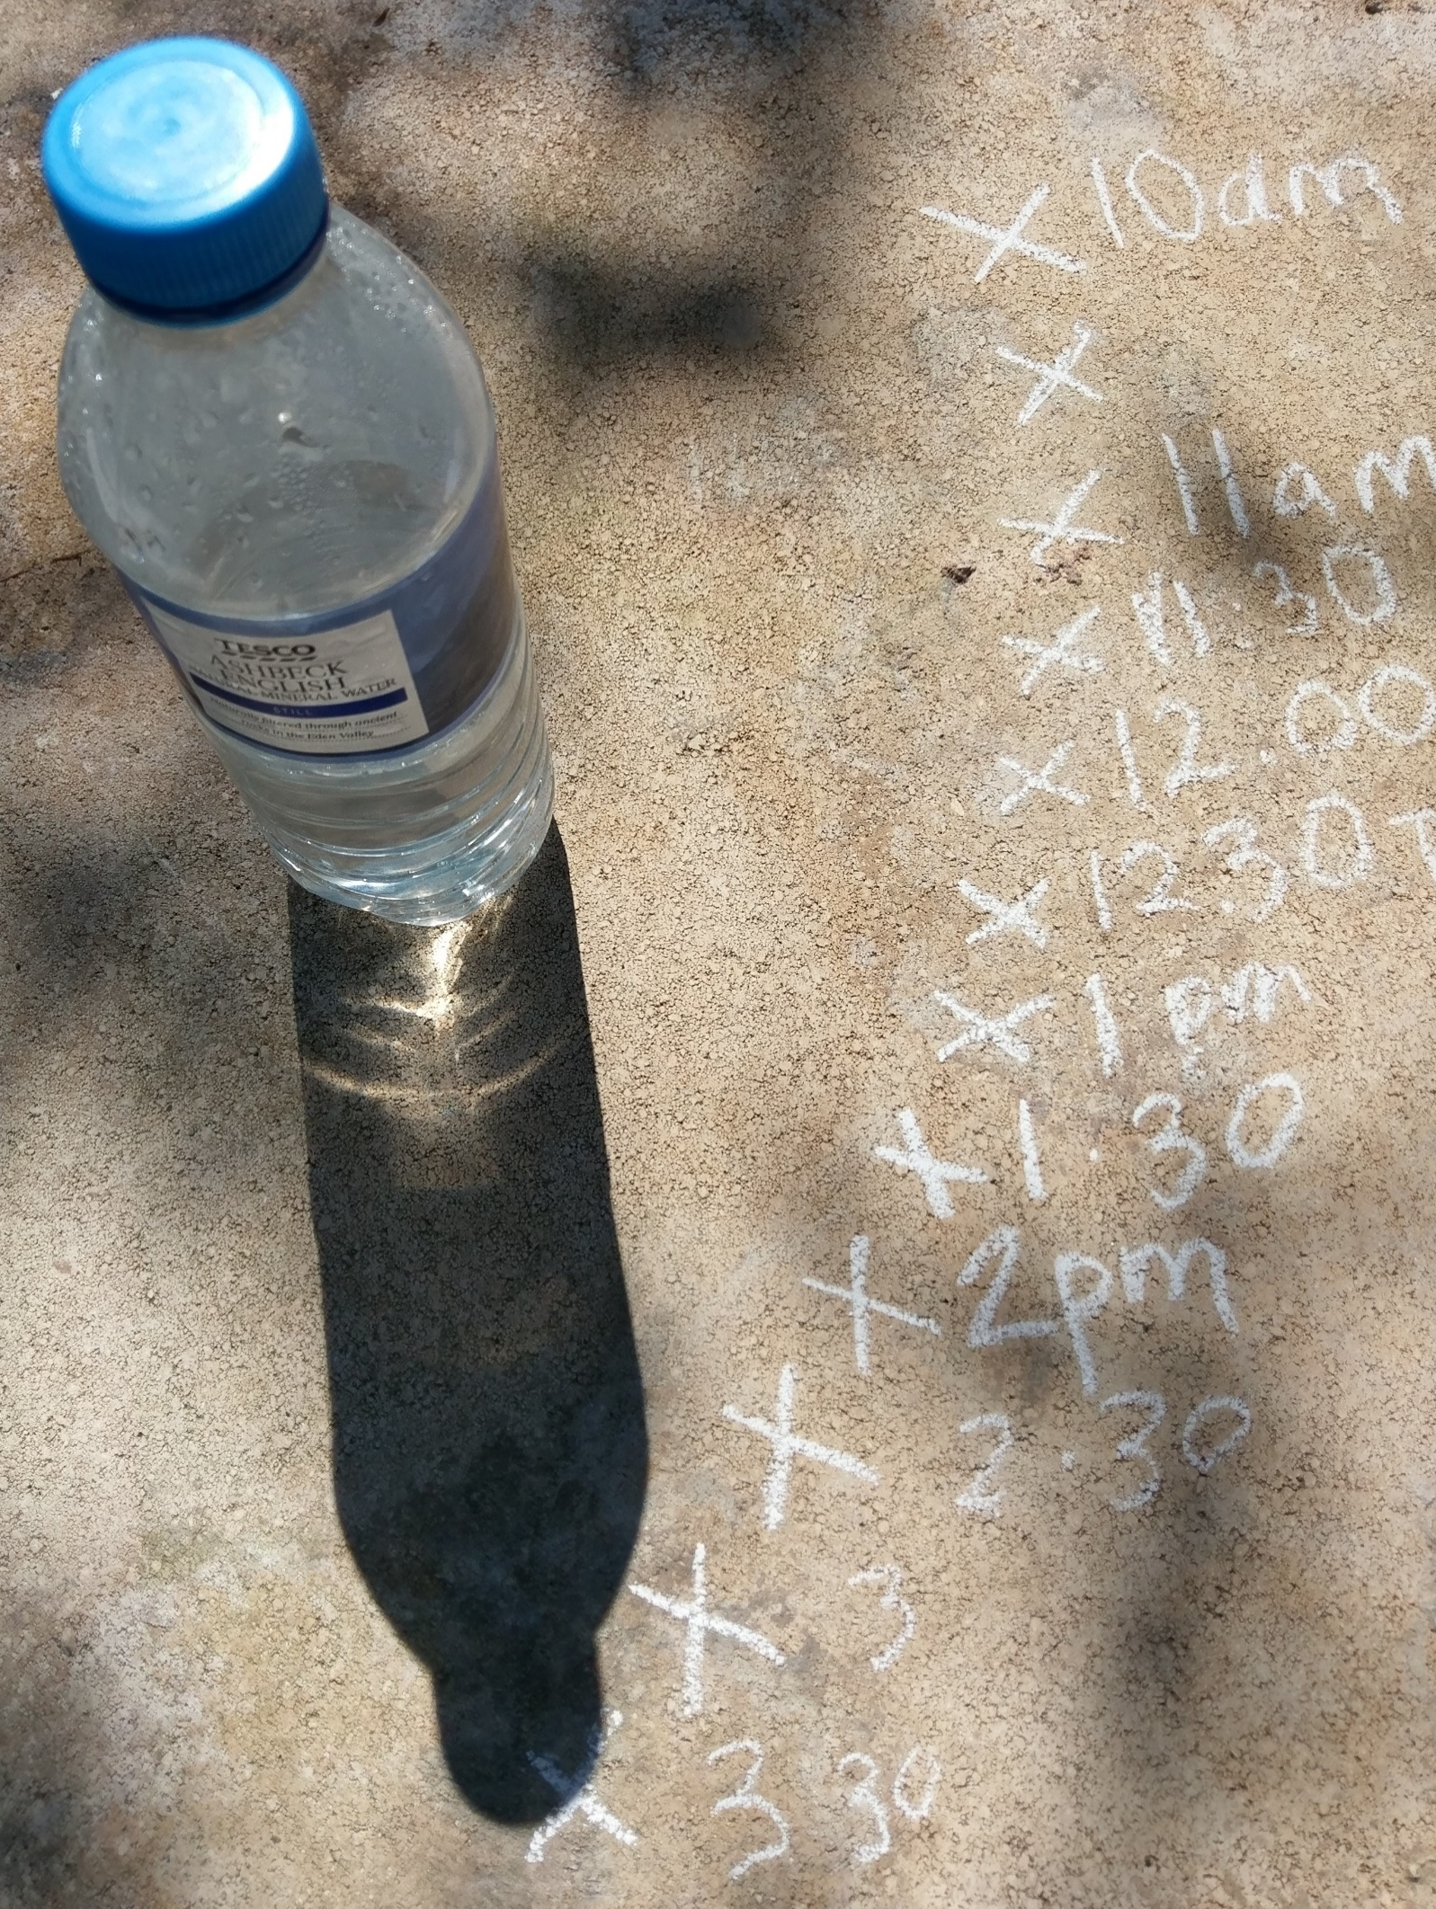
Investigating how shadows change size through the day
Taking accurate measurements and plotting them on a graph as you go along
(Around 1 hour in total, 5-10 minutes each reading, repeated about 8-12 times during the day)
Which direction did the sun rise in?
Use black or this blue colour
1. Starting in the morning, find a sunny place with a paved/hard surface at least 10 steps away from any buildings and mark a star on the ground with chalk or pencil.
2. With your water bottle/object standing on the star, mark a cross at the top of its shadow.
3. Check the time.
4. Measure the distance between the star and cross, in centimeters and to one decimal place.
5. Record this (as the size of the shadow) and the time from step 3 in a table (see page 5).
6. Plot this point on your line graph (see page 5).
Scientists normally plot their data as they go along so they can see any patterns emerging or if a particular result doesn’t seem to fit this (and may need checking).
7. Repeat steps 2-6 every half hour or so until mid-afternoon.
8. Draw a smooth line of best fit for your data. This curve should go as close as possible to as many of your data points as possible.
10am cross
star-to-cross distance for 10am star
star (under bottle)

Slide 5
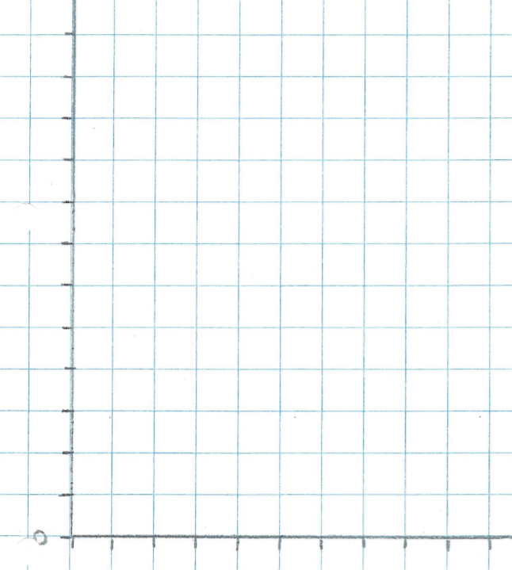
I can observe and record the size of shadows throughout the day
I can plot a line graph of results taken to one decimal place
I can draw a conclusion from my data
Sample results in case it’s not a sunny day when you do this lesson!
Time (hours:mins) | Size of shadow (cm)
Time (hours: mins) | Size of shadow (cm)
10:00am | 21.7
10:30am | 19.8
11:00am | 17.3
11:30am | 16.0
12:00pm | 14.8
12:30pm | 14.3
1:00pm | 14.1
1:30pm | 14.5
2:00pm | 15.3
2:30pm | 16.4
20
Size of shadow (in cm)
Conclusion
Because the shadow is _____________ at _____pm, this means the sun is highest in the sky at this time in the ____________(season).
10
10:00
2:00
Time (hours:minutes)

Slide 6
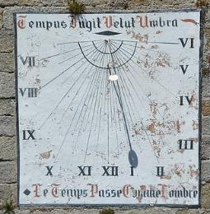
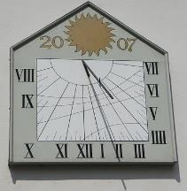
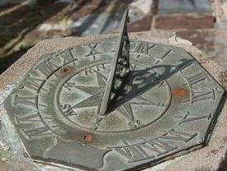
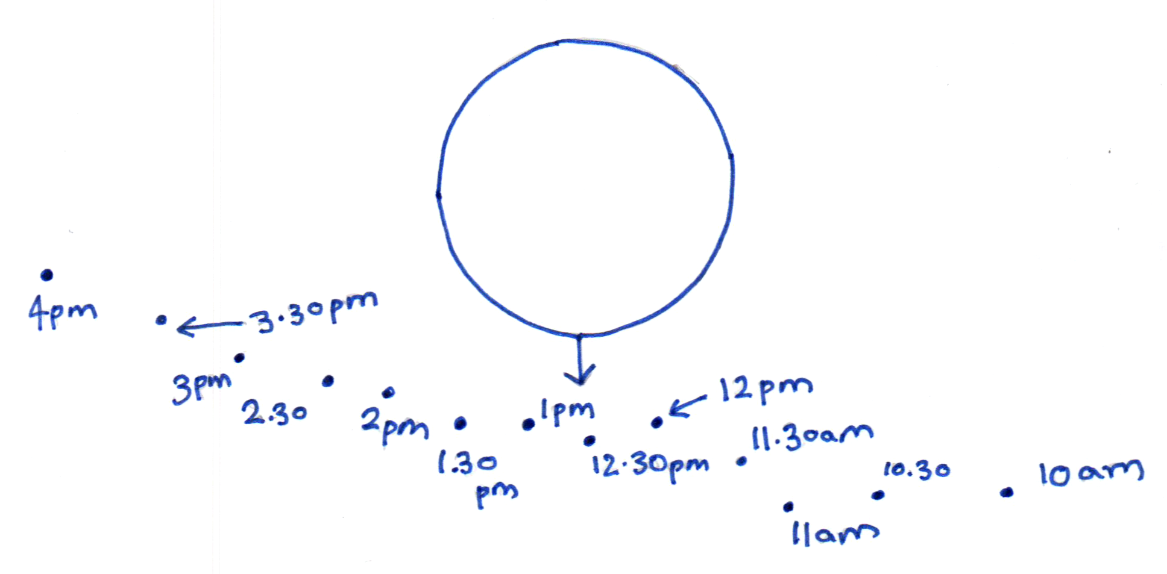
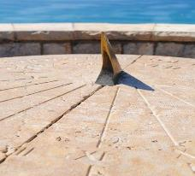
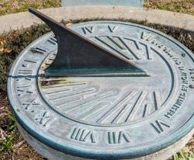
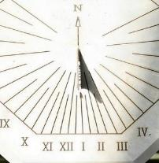
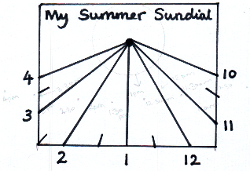
Find out more…
Explore how you can use shadows to tell the time
(Optional)
Think or talk about…
What time was each of these photographs of sundials taken?
How does a sundial work? Explain this using at least 8 scientific words or phrases.
Tomorrow, if you want to, you could make a sundial. To do this, you could use, say a cocktail stick stuck in a plastic milk bottle lid/pencil rubber as the object and paper/card. You would first need to mark the direction of the shadow on the hour, every hour e.g. 9am, 10am, 11am etc. keeping the paper in the same place each time. You could alternatively do this every half hour. Once calibrated in this way, you can use your sundial to tell the time (on another sunny day in the same place).
Calibration measurements … and the finished sundial

Slide 7
Glossary of terms
axis: An axis is an imaginary line around which something rotates. The Earth’s axis is a made-up ‘line’ passing through its centre, connecting its North and South poles.
calibrate: When a measuring device is calibrated, it is marked with a standard set of readings.
line of best fit: The line of best fit is a straight line or a smooth curve that shows the pattern of your results and goes as close to as many points as possible. It isn’t a dot-to-dot!
opaque: Opaque materials/objects block all light.
rotate: Something rotates when it moves in a circle around an axis.
screen: A screen is a surface on which a shadow is seen.
shadow: A shadow is a dark area caused by blocking light from reaching a surface.
sundial: A sundial is a device for timekeeping that uses a shadow cast by the position of the Sun on a marked scale. Sundials date back to ancient Egyptian times, about 1500 BC.

Slide 8
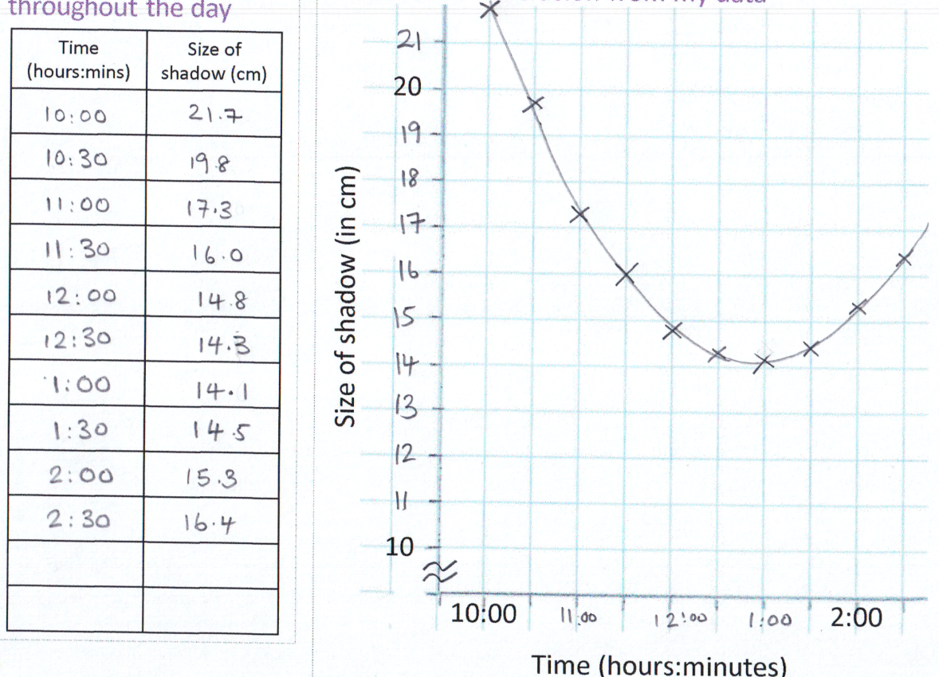
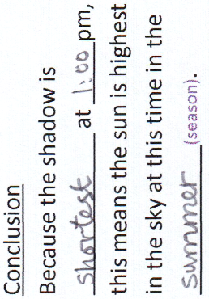
Possible learning outcome for reviewing your work:
I can observe and record the size of shadows throughout the day
I can plot a line graph of results taken to one decimal place
I can draw a conclusion from my data
The line of best fit should clearly be a curve in this case (not a straight line, or dot-to-dot). It should pass close to as many data points as possible.
Your rows of results should only have numbers (not units), since the units are shown in the header line so they apply to all rows of the table
During British summertime (when the clocks are one hour ahead of Greenwich Mean Time - GMT), the sun is highest in the sky at 1:00 (rather than noon), so the shadows are shortest then.
Always use a pencil to plot graphs, in case you make a mistake.
The y-axis does not start at zero here.
Your graph scales should always go up by a fixed amount between each evenly-spaced mark.

